Slide 1
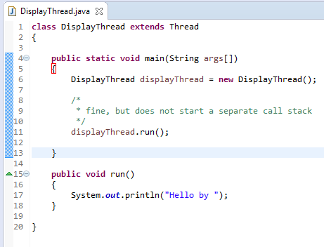
What if we call run() method directly instead start() method?
Each thread starts in a separate call stack.
Invoking the run() method from main thread, the run() method goes onto the current call stack rather than at the beginning of a new call stack.

Slide 2
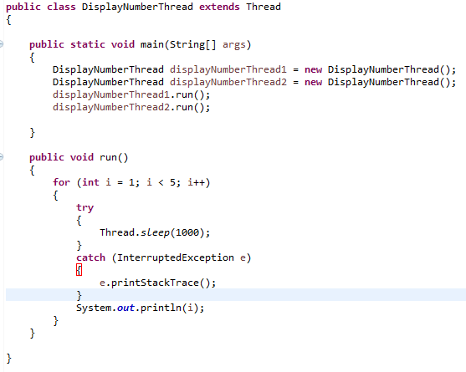

What if we call run() method directly instead start() method?
As you can see in this program that there is no context-switching because here displayNumberThread1 and displayNumberThread2 will be treated as normal object not thread object.

